Slide 1

PRACTICAL CONVERSATION A1
BY MR.MATTOS

Slide 2

COMO DAR INFORMAÇÕES PESSOAIS
HI,
MY NAME IS BOANERGES.
I AM 63 YEARS OLD.
I LIVE IN UNIVERSITÁRIO NEIGHBOURHOOD.
I AM ..... (MARRIED, SINGLE, DIVORCED)
I HAVE .... ( NO) CHILDREN).
I AM A(AN) ...... (STUDENT, TEACHER)
I WORK FOR/ STUDY AT.... (ESCOLA DE TURISMO DO CEARÁ)

Slide 3
COMO DAR INFORMAÇÕES PESSOAIS
I AM 1,67
I WEIGH 75KG.
I HAVE DARK BROWN EYES AND SHORT, STRAIGHT, DARK BROWN HAIR.
I LIKE CALZONI.
I DON´T LIKE OKRA.

Slide 4
COMO FALAR DE TERCEIROS
HIS/HER NAME IS...
HE/SHE IS ....YEARS OLD.
HE /SHE LIVES IN....NEIGHBOURHOOD.
HE/SHE IS ...MARRIED/SINGLE/ DIVORCED.
HE/SHE HAS....(NO) CHILD(REN).
HE/SHE IS A/NA...
HE/SHE WORKS FOR/STUDIES AT....

Slide 5

COMO FALAR DE TERCEIROS
HE/SHE IS...
HE/SHE WEIGHS...
HE/SHE HAS....EYES AND HE/SHE HAS....HAIR.
HE/SHE LIKES...
HE/SHE DOESN´T LIKE...

Slide 6
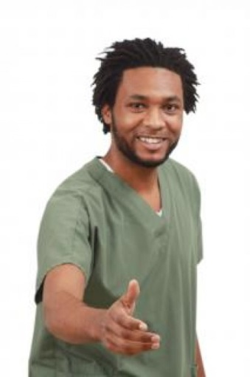
COMO SE APRESENTAR
HELLO, I AM PETER.
HI, MY NAME IS PETER.
GOOD MORNING, I AM PETER.
GOOD AFTERNOON, MY NAME IS PETER.
GOOD EVENING, MY NAME IS PETER.
GOOD NIGHT, I AM PETER.

Slide 7
CUMPRIMENTOS EM APRESENTAÇÃO
NICE TO MEET YOU.
PLEASED TO MEET YOU.
GLAD TO MEET YOU.
HOW DO YOU DO?

Slide 8

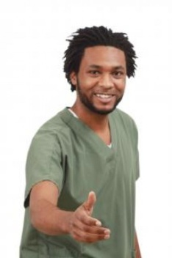
COMO PERGUNTAR E DAR O NOME
WHAT´S YOUR NAME?
CAN I HAVE YOUR NAME?
YOUR NAME, PLEASE?
MY NAME IS ................................

Slide 9
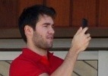

PERGUNTAR E DAR O NOME DE TERCEIROS
WHAT´S HIS NAME? HIS NAME IS PAUL.
WHAT´S HER NAME?
HER NAME IS JANE.

Slide 10

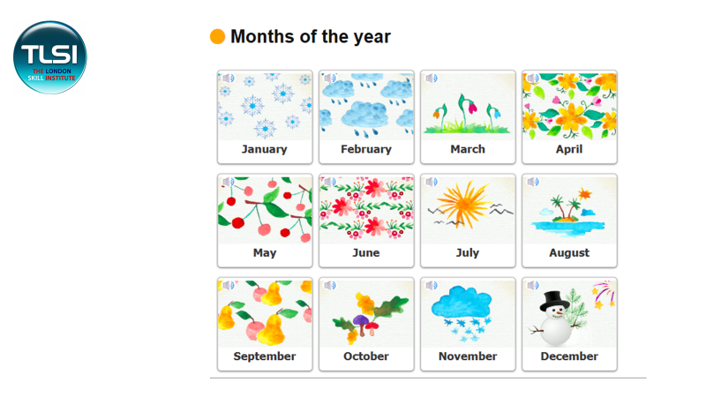
(2026)
A YEAR HAS 12 MONTHS.
A DAY HAS 24 HOURS.
A MONTH HAS 30/31 DAYS.
I WAS BORN ON THE 4 OF MARCH
A MONTH HAS 4 WEEKS.
MY BIRTHDAY IS IN MARCH.

Slide 11
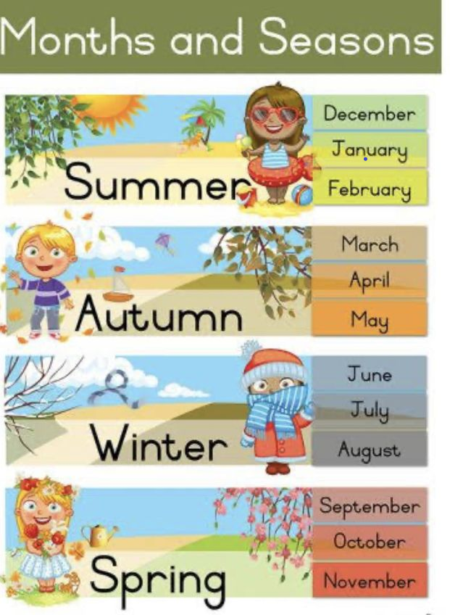
is a ___ month.
Fall
is an __ month.
is a ___ month.
is a ___ month.

Slide 12
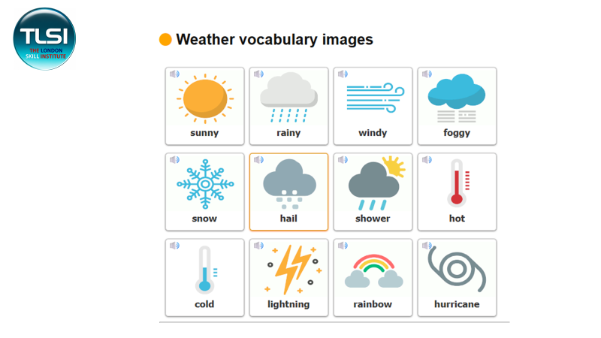

Slide 13
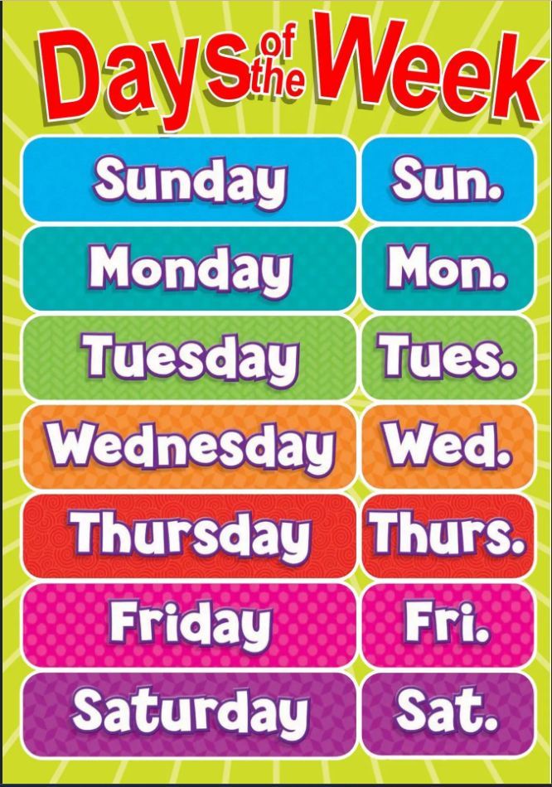
...IS THE FIRST(1st.) DAY OF THE WEEK.
...IS THE SECOND(2nd.) DAY OF THE WEEK.
...COMES BEFORE....
...COMES AFTER....
...IS THE THIRD(3rd.) DAY OF THE WEEK.
...IS THE FOURTH(4th.) DAY OF THE WEEK.
...IS THE FIFTH(5th.) DAY OF THE WEEK.

Slide 14
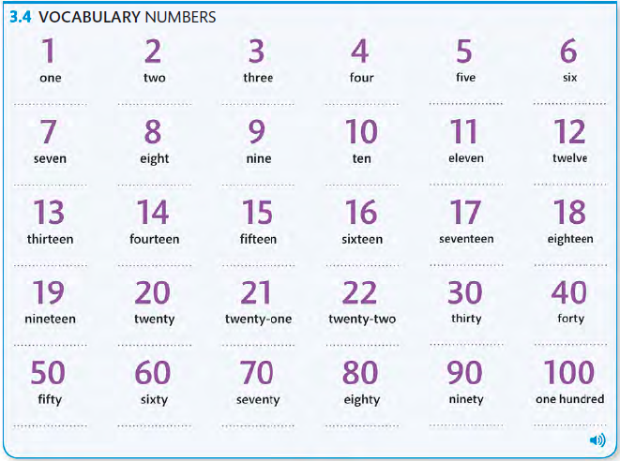

Slide 15
Confusing numbers
13
30
14
40
15
50
Teen
Tea
16
60
17
70
18
80
19
90

Slide 16
COMO PEDIR E DAR O NÚMERO TELEFONE
WHAT´S YOUR PHONE NUMBER?
(54) 99965-9178
MY NUMBER IS______.
WHAT´S HIS / HER TELEPHONE NUMBER?
HIS / HER NUMBER IS______.

Slide 17
O ALFABETO EM INGLÊS
A B C D E F G H I J K L M N O P Q R S T U V W X Y Z

Slide 18
COMO PERGUNTAR E DIZER COMO SE ESCREVE
HOW DO YOU SPELL_____?
YOUR NAME
YOUR FIRST NAME
YOUR LAST NAME

Slide 19



COMO PERGUNTAR E DAR A NATURALIDADE/NACIONALIDADE DE ALGUÉM
Where are you from?
I´m from Brazil. I´m Brazilian.
Where is he from?
He´s from Mexico. He´s Mexican.
Where is she from?
She´s from Japan. She´s Japanese.

Slide 20
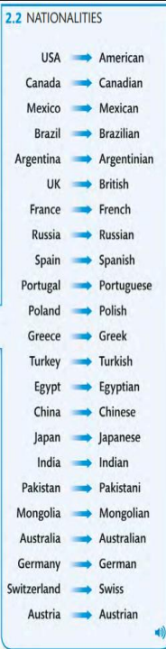

Slide 21
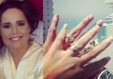
COMO APRESENTAR TERCEIROS
THIS IS REGINA
JOSHUA
THAT IS

Slide 22
COMO PERGUNTAR E DIZER COMO ESTÁ.
HOW ARE YOU? I´M FINE. AND YOU?
HOW´S IT GOING? NOT BAD. HOW ABOUT YOU?
HOW ARE YOU DOING? PRETTY WELL.
HOW´S JACK? HE´S FINE.
HOW´S JANE GOING? SHE´S GREAT!

Slide 23


COMO IDENTIFICAR ALGUÉM
EXCUSE ME, ARE YOU______?
        YES, I AM. NO, I AM NOT.

Slide 24
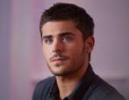
COMO IDENTIFICAR TERCEIROS
  WHO IS HE_____? HE IS PAUL.
  WHO IS SHE?
  SHE IS JANE.

Slide 25

COMO IDENTIFICAR MAIS DE UMA PESSOA
  WHO ARE THEY? THEY ARE THE LIMAS
  WHO ARE THESE?
  WHO ARE THOSE?

Slide 26
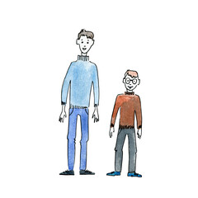
COMO PEDIR DESCRIÇÃO E DAR DESCRIÇÃO.
What do you look like?
I am tall with short dark brown straight hair and blue eyes.
Tall
Short

Slide 27
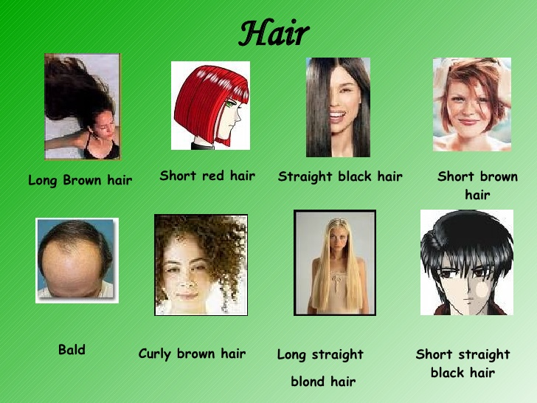
COMO DESCREVER O CABELO DE ALGUÉM

Slide 28
COMO PEDIR E DAR O ENDEREÇO
Where do you live?
I live at 1370 Bramante Mion St. Apt.347
What´s your address?
My address is 214 Fortunato J. Rizzardo St.
Where does he / she live?
He / She lives at 47 Vitório Valente St.
What´s his / her address?
His / Her address is 601 G. Avenue.

Slide 29
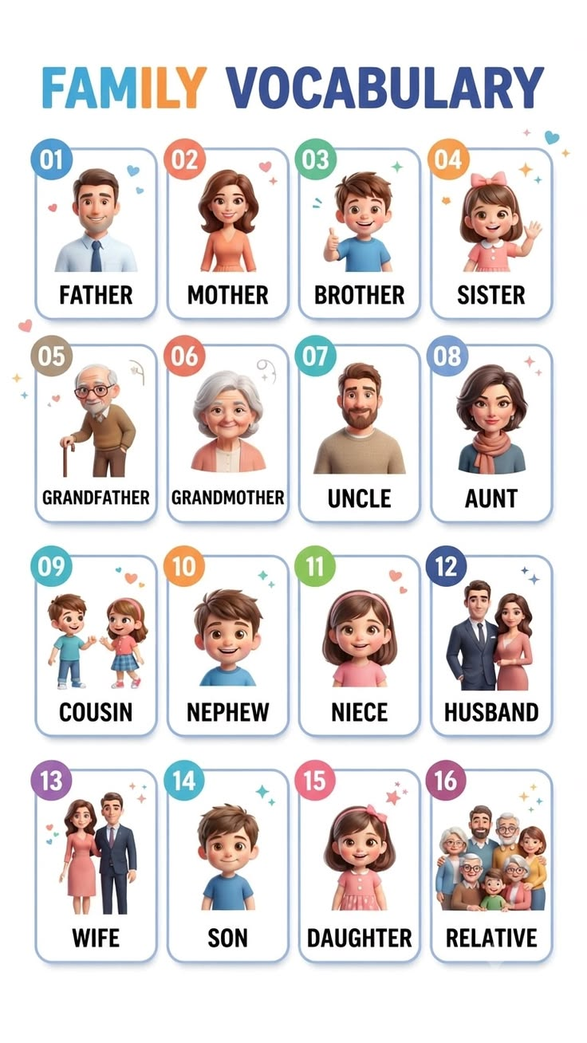

Slide 30
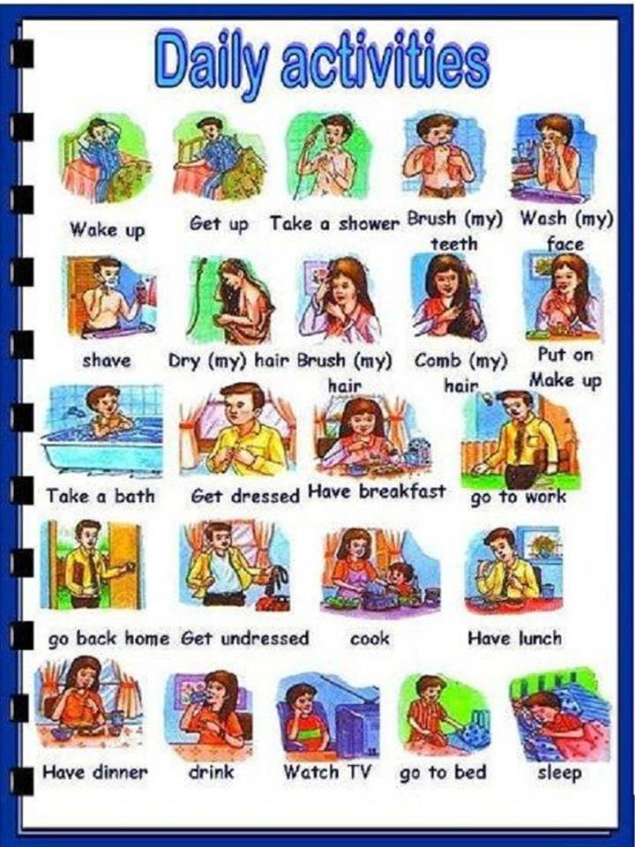

Slide 31
COMO PERGUNTAR E FALAR DO QUE SE FAZ DIARIAMENTE
WHAT DO YOU DO EVERY DAY?
I TAKE A SHOWER EVERY DAY.
EVERY MORNING
IN THE AFTERNOON, MORNING, EVENING, AT NIGHT
AFTER BREAKFAST
BEFORE DINNER
EVERY WEEKEND
EVERY MONDAY MORNING

Slide 32
COMO PERGUNTAR E FALAR O QUE TERCEIROS FAZEM TODO DIA
WHAT DOES KATE DO EVERY MORNING?
            SHE HAS BREAKFAST.
EVERY WEEK
EVERY MONTH
EVERY YEAR
ON MONDAY AFTERNOON
IN THE EVENING
AT NIGHT
AFTER GETTING DRESSED
BEFORE WASHING HER FACE

Slide 33
COMO PERGUNTAR E FALAR O QUE ESTÁ FAZENDO NO MOMENTO
WHAT ARE YOU DOING RIGHT NOW?
          I´M DRYING MY HAIR.
  WHAT IS PETER DOING RIGHT NOW?
            HE´S WALKING THE DOG.

Slide 34
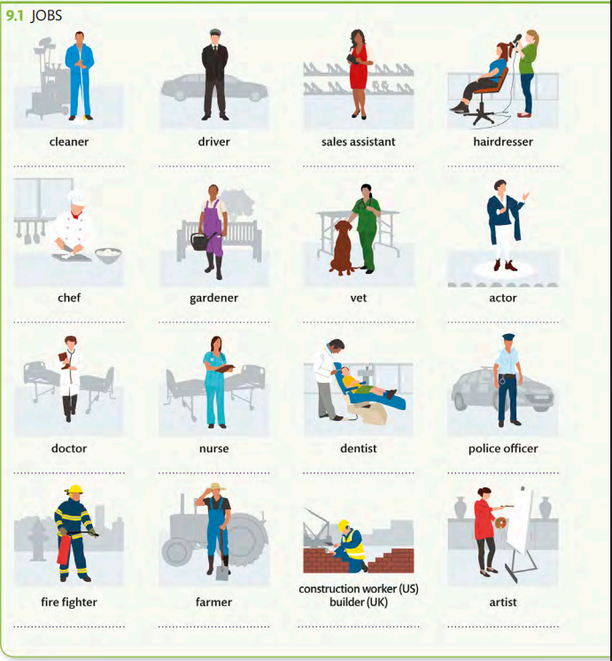

Slide 35
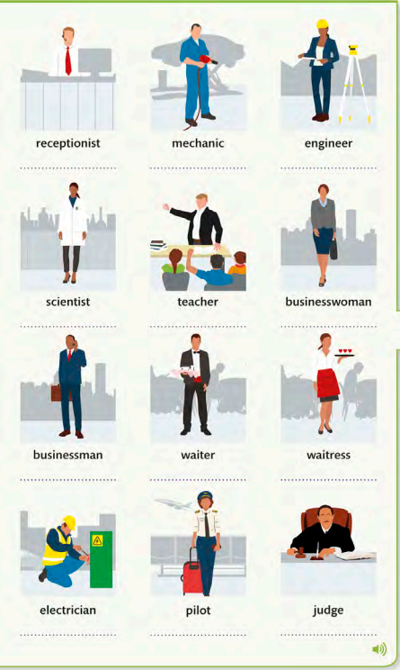

Slide 36
COMO PERGUNTAR E DAR A PROFISSÃO
What do you do? I am a Teacher.
What does Paul do? He is a Dentist.
What does Kate do? She is na Engineer.
What are you? I am a Police officer.
What is Jack? He is a Pilot.
What is Susan? She is a Nurse.

Slide 37


Slide 38

What do
you like
to do in
your free time?
I like cooking.
What´s your hobby?
My hobby is Dancing.

Slide 39
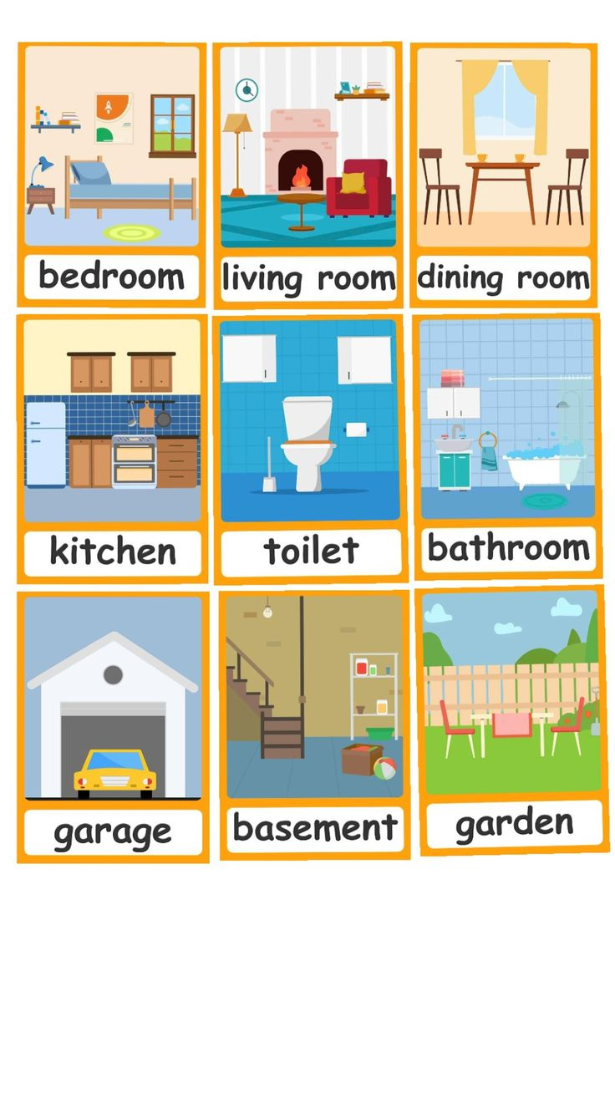
THE HOUSE

Slide 40
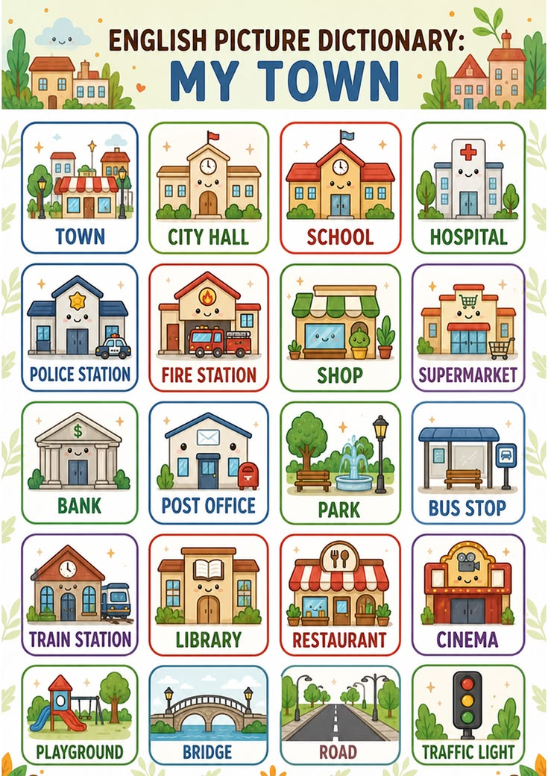
Bento Gonçalves is a big town.
The city hall is downtown.
There are public and private schools in Bento Gonçalves.
Bradesco bank is on Mal. Floriano St.
Tacchini hospital is near the Post office.
The Cinema/Movies is in Bento Shopping Center.
Tacchini hospital is near the Post office.

Slide 41
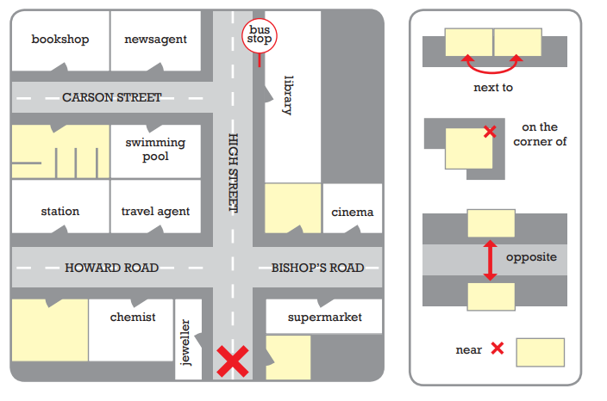
MAP
Go straight a head Take the first left Go up
Go past the supermarket. Turn right Go down

Slide 42
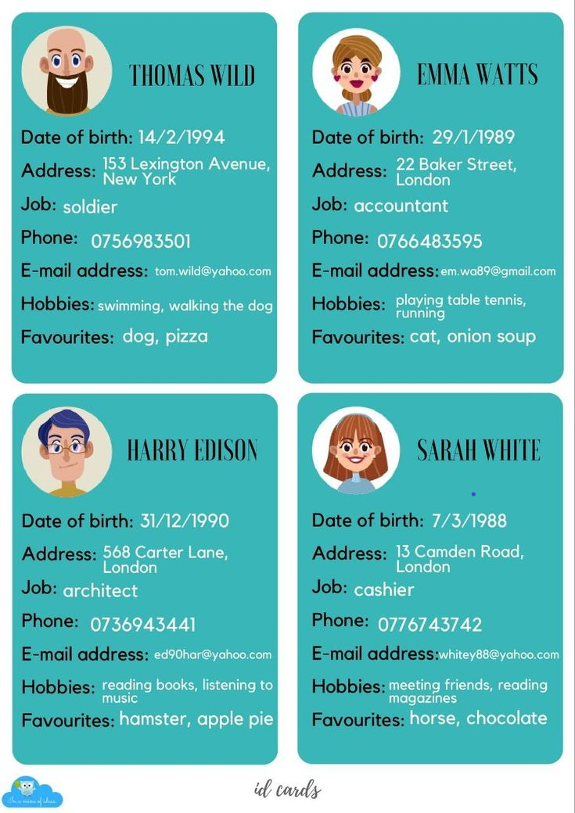

Slide 43
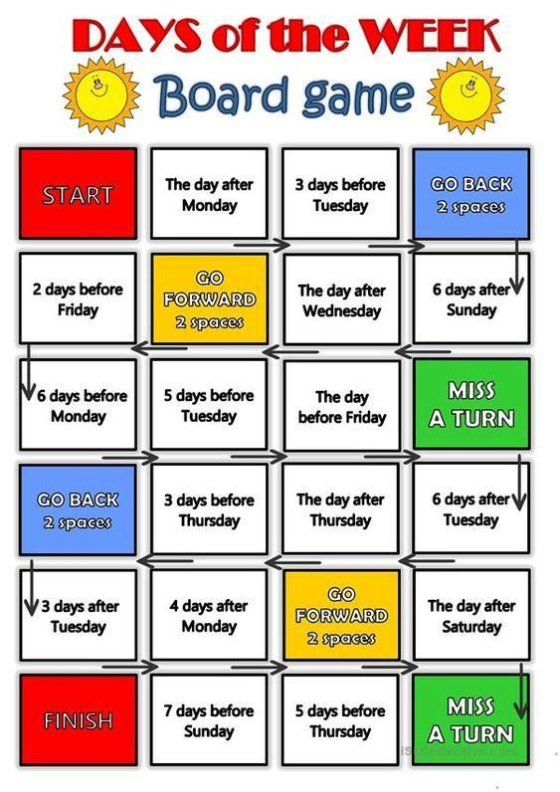

Slide 44
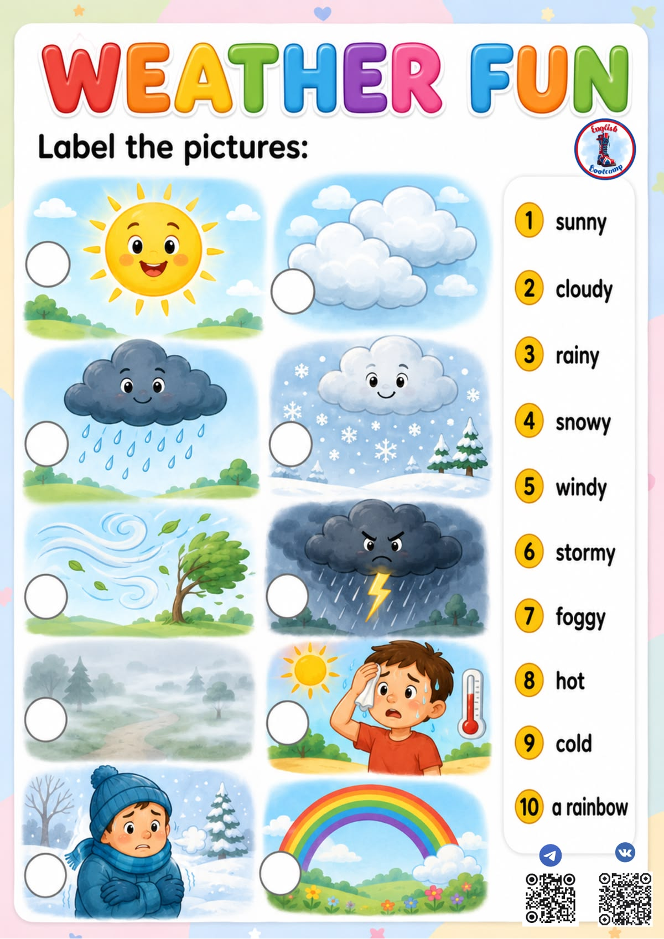

Slide 45
